Slide 1
Amazon Book Recommendation
Review Based Text Analysis

Slide 2
Problem Statement
Recommending the top rated books to the user
Genre and Author based Recommendation
Incentivized Reviews analysis using NLP
Text Analytics using LDA and K-Means Algorithm

Slide 3
Dataset Information
Amazon Book and User recommendation
7 million records (train dataset)
2 million records (test dataset)
Text Analytics using NLP and LDA
2 million records
Data Visualization
1,50,000 records

Slide 4
Data Analysis
Distribution of Ratings over the reviews.
Year wise Reviews analysis.
Rating wise Helpfulness analysis.
Genre Based Ratings analysis

Slide 5
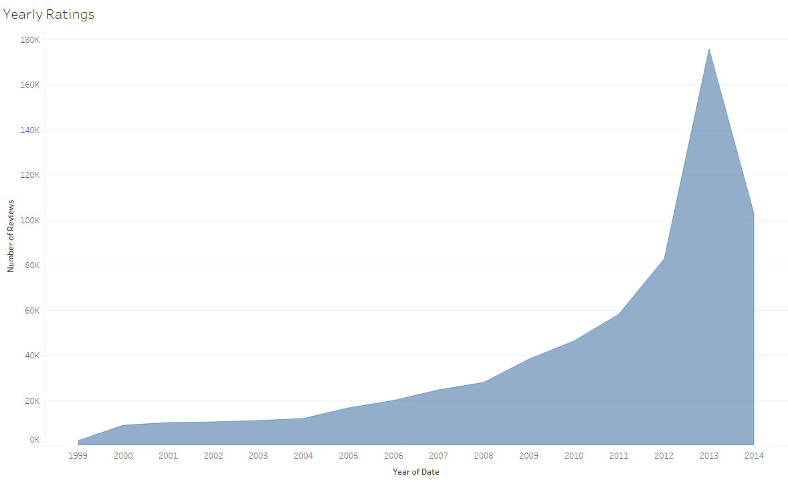
Year wise Reviews Analysis

Slide 6
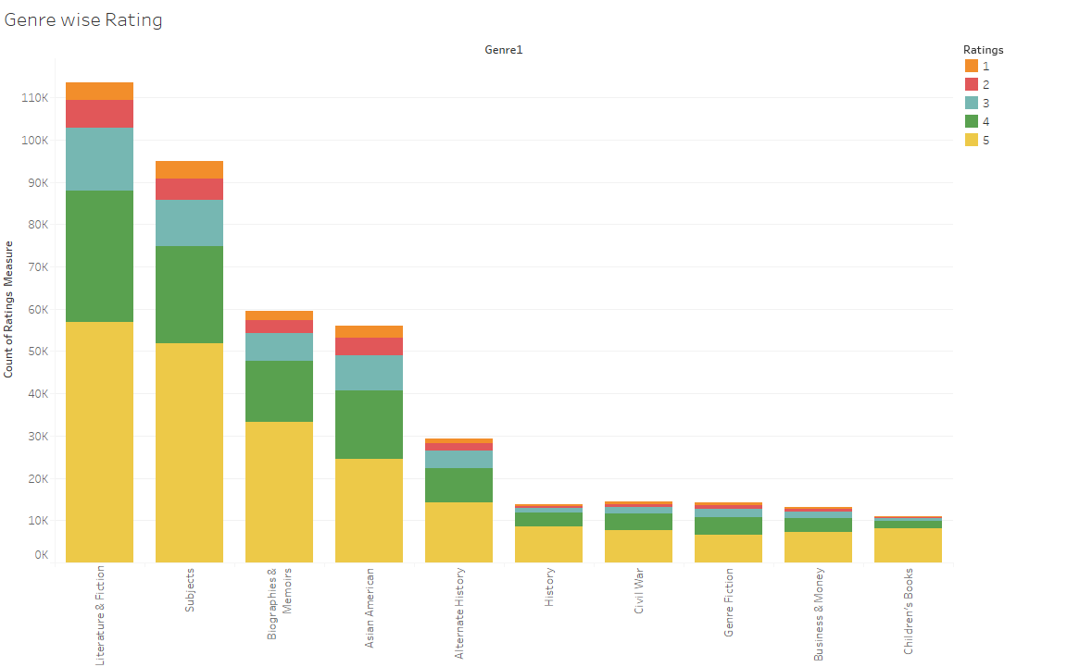
Genre Based Ratings

Slide 7
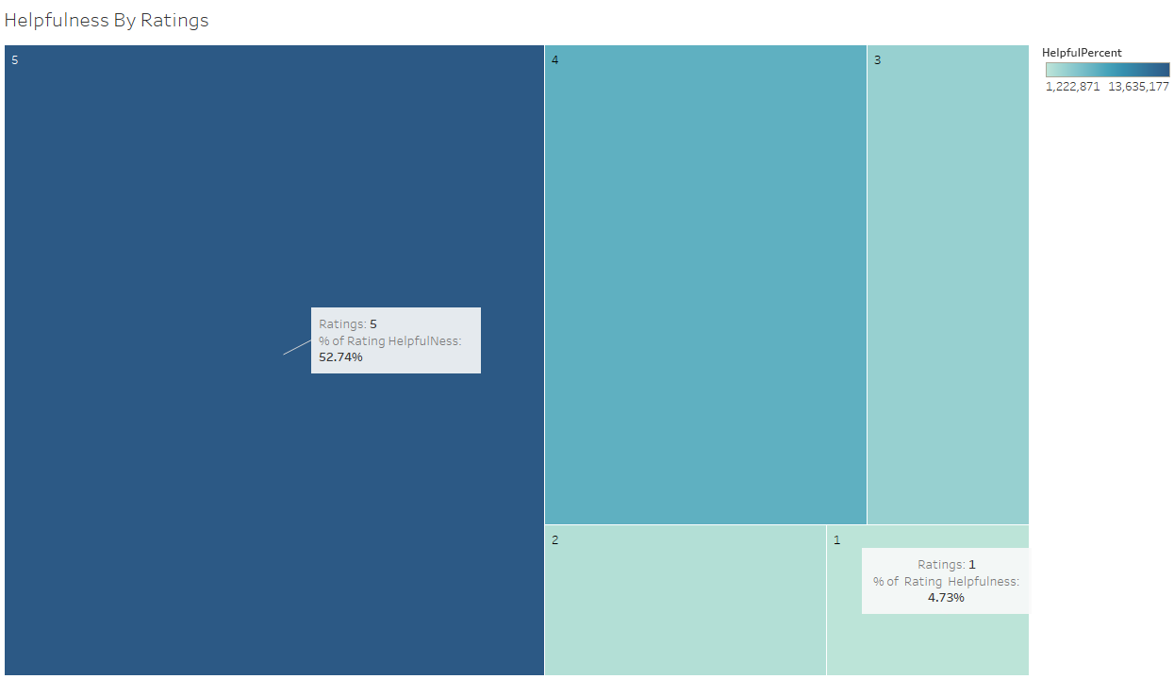
Helpfulness by Ratings

Slide 8
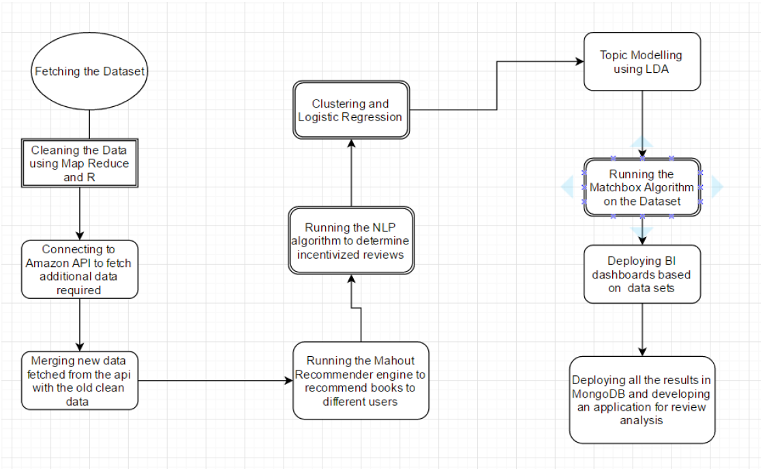
Application-wide Integration

Slide 9
Text Analytics
Used Stanford NLP algorithm to analyze incentivized reviews.
Performed topic modeling on book reviews using LDA (Latent Dirichlet Allocation)
Performed Logistic regression and K-means clustering to analyze correlation between helpfulness and review text.

Slide 10
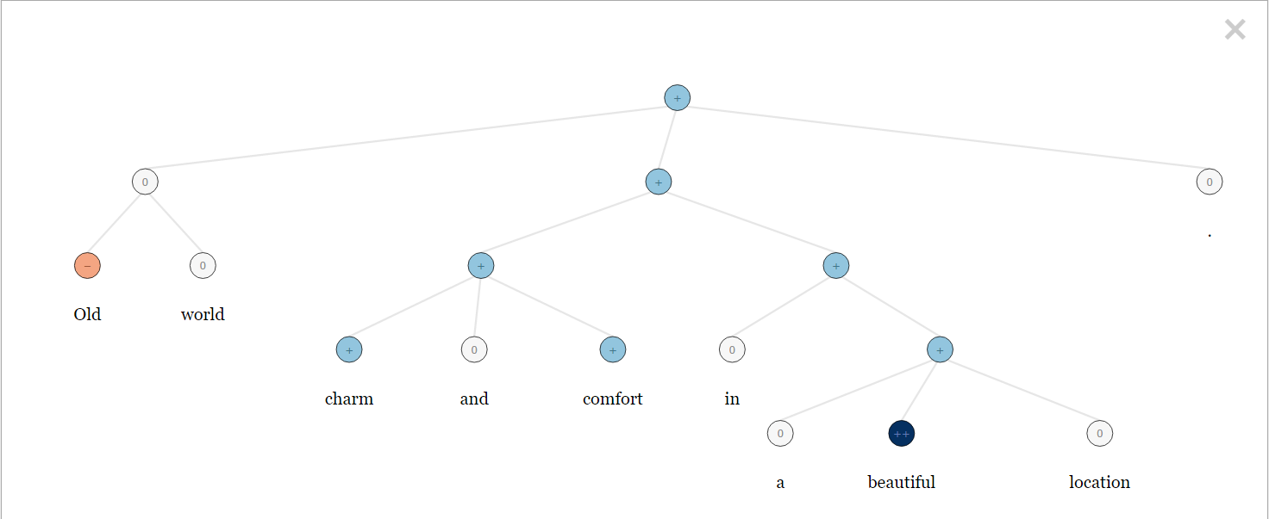
Sentiment Analysis – RCN example - Old world charm and comfort in a beautiful location.

Slide 11
Machine Learning
Feature selection
Bag of Models vs Logistic Regression

Slide 12
Application Development
Used MongoDB server to store data and display on the front end.
Integrated MongoDB with java spring MVC.
Restful API using azure to get real time data.

Slide 13
Thank you & Questions!!

